Slide 1
Project On Phishing Sites Predictor
By Tarun Tiwari

Slide 2

Contents
Proposed Approach
Explanations
Live Demo of Phishing Sites Prediction
Deployment
End

Slide 3

Proposed Approach:-
Collection of Data
Split the Data Into Train and Test set
Build The Model
Train the Model
Results
Deploy The Model
Import Links To Prediction

Slide 4
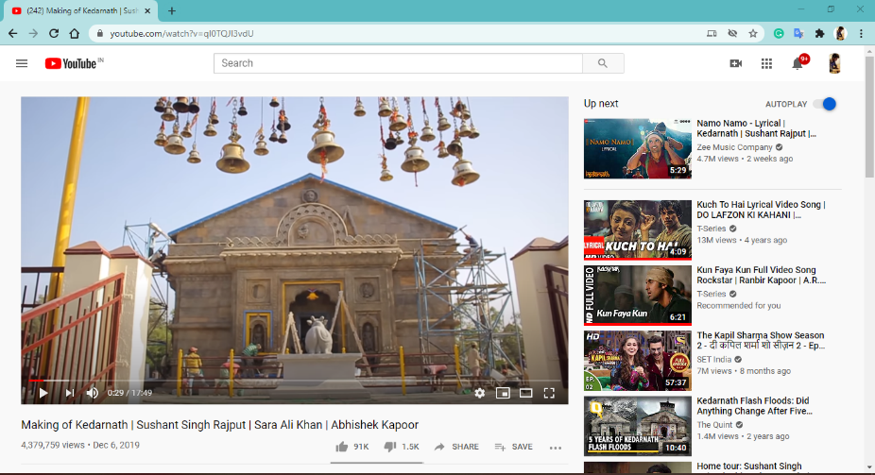
Project Overview:-
Target Label
Phishing site
Not Phishing Site
Classifier
Training links
Testing links

Slide 5
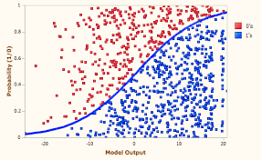

Project Overview (How it actually Works)
Fit data
Pulling
Converting
Tokenizes
Transforms
text
Results

Slide 6
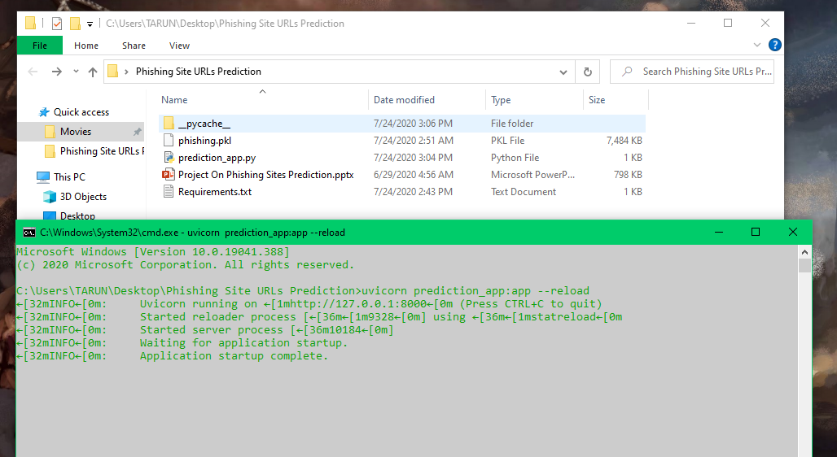
MODEL DEPLOYMENT USING FASTAPI

Slide 7
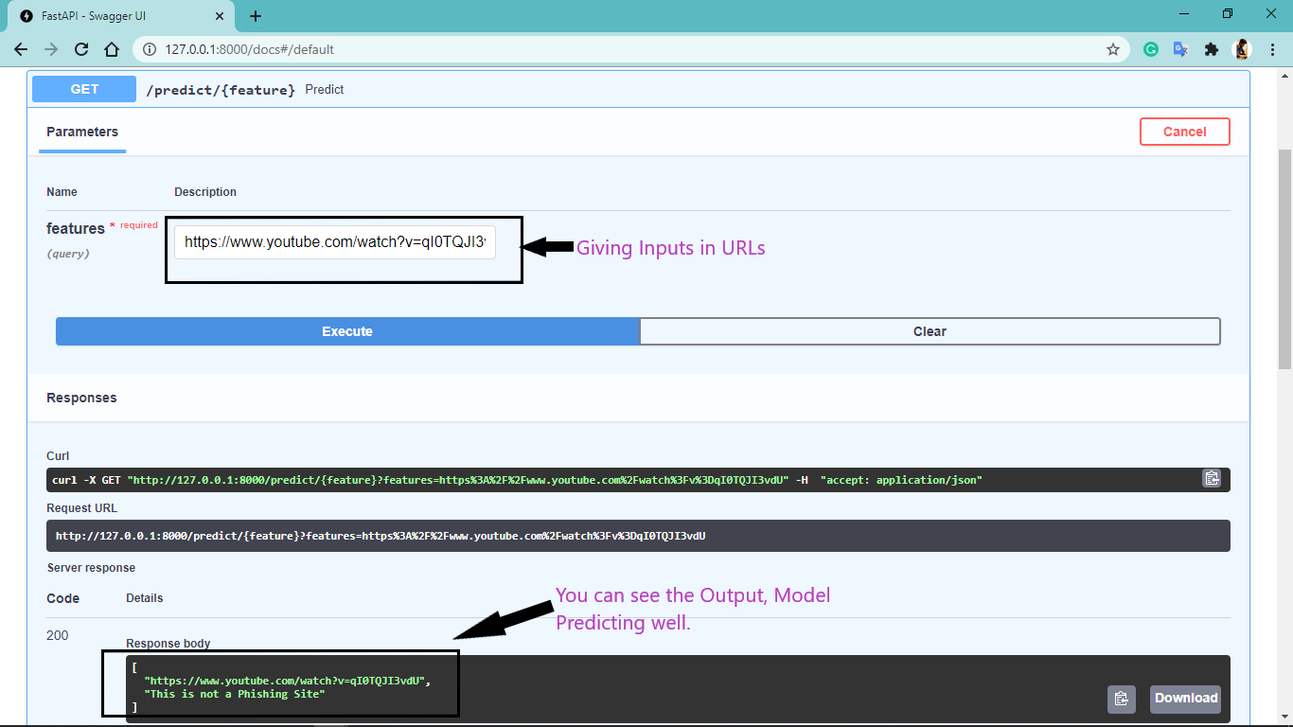
Prediction Good Sites

Slide 8
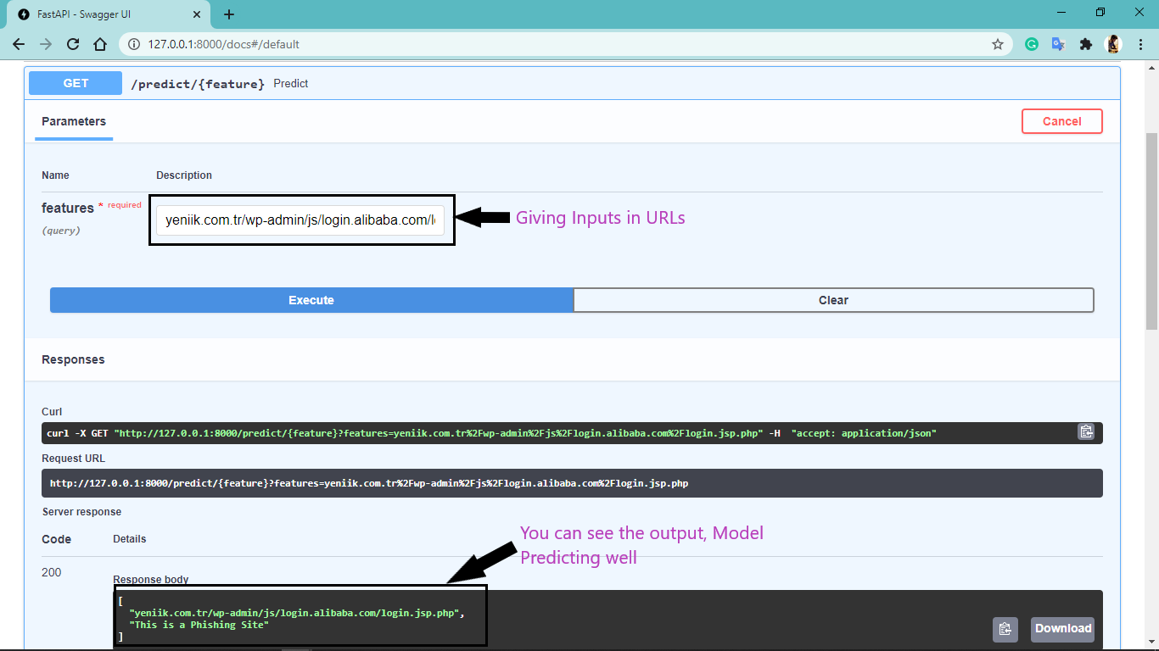
Prediction Phishing Site

Slide 9

Thank You By Tarun Tiwari

